Slide 1
Parallel Algorithms in Computational Geometry
by
Savitha Parur Venkitachalam

Slide 2
Agenda
Computational Geometry Introduction
Serial and Parallel Algorithm for Orthogonal Range searching
Serial and Parallel Algorithms for Convex Hull
Questions

Slide 3
Computational Geometry
Class of problems which can be stated in terms of geometry
Applications in Geographic information systems , Computer Graphics , Searching a Database , Robotics , Tetrahedral mesh generation , Design of VLSI circuits.
Examples
Convex Hull
Delaunay triangulation
Range Searching
Nearest Neighbor
Notes:
Applications – Geographic information systems , molecular studies
Tetrahedral mesh generation using delaunay triangulations are used in

Slide 4
Parallel Algorithms
Why Parallel?
mostly used in online applications where short response times are a necessity
Often requires large amount of data to be processed
Parallel Models used
PRAM and CREW-PRAM
Hypercube
Mesh
Linear array
Mesh of trees
Pyramid
Notes:
Pram – parallel random access machine set of processors connected to a shared memory
Crew pram –

Slide 5
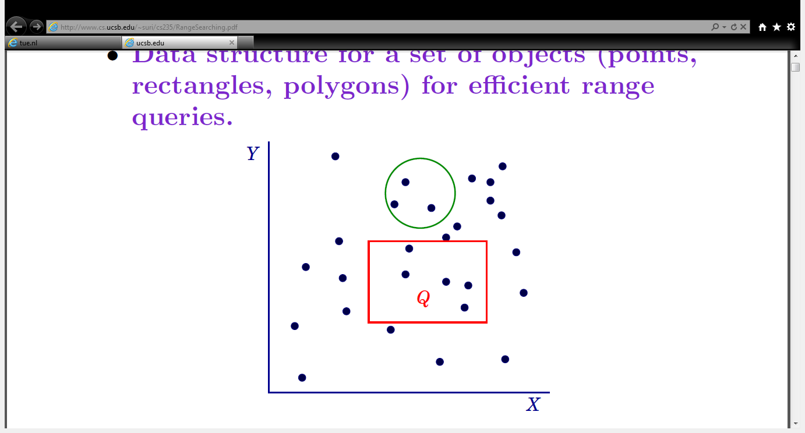
Orthogonal Range Searching
Preprocess a set of data such that it answers the range queries in an efficient way
Records in the data base can be viewed in a multi dimensional space
Divide the data into geometric subsets like set of rectangles , triangles or circles.

Slide 6
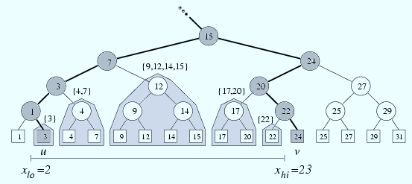
1 D range searching
Process the data and store it in a balanced binary search tree
Input - range tree and range [x , x’]
Output – all points in the range
Notes:
No hash because more than one record may have same key . So a unique hash function cannot be assigned to each record.

Slide 7
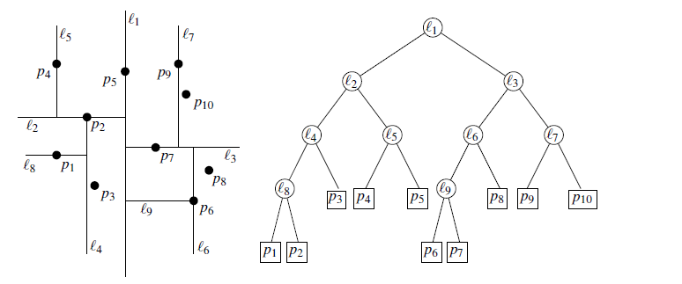
2D range searching - Preprocessing
Query is based on the range [x-x’] [y-y’]
Data space is divided into subsets using the median of X and Y coordinates alternatively
A KD – tree can be used to store the subsets

Slide 8
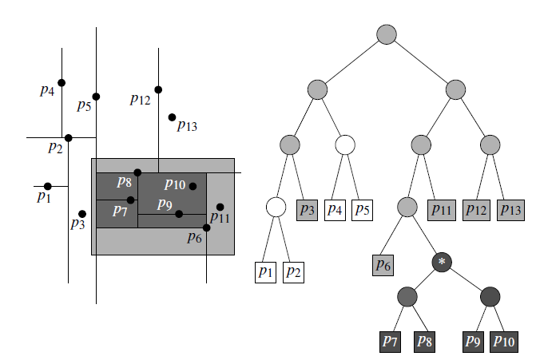
2D Orthogonal Query searching
Input – The root of KD tree , Range (x-x’)(y-y’)
Output – Set of points in the range
Start from the root node.
If the subtree is fully contained in the range report the whole subtree
If the subtree intersects the range then scan the subtree

Slide 9
Parallel Approach – K Windows Algorithm
Before Preprocessing partition the database among the processors
Each processor builds local KD-tree on the set of data it owns
Each processor performs the range search on its local KD-tree
Load balancing could be used when one processor has data disjoint of the range
Server combines the result from all the processors
Does not require much communication among the processors

Slide 10
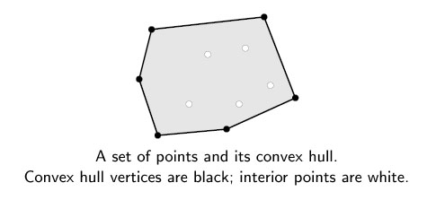
Convex Hull
Given a set of points in a plane P , convex hull is the largest convex polygon whose vertices are all in P.
Notes:
It has many applications in computer graphics – to find an approximate location of an object as a very simple descriptor of its shape.
GIS – In case of a natural disaster emergency planners may easily calculate the emergency response times using GIS.
Visual pattern recognition – detecting car plates

Slide 11
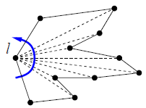
Serial Algorithms
Brute force
Divide and Conquer
Graham Scan
Select the left most point as pivot
Sort the rest of the points by polar angles with respect to the pivot
March around this points and build the hull
Add edges when left turn and backtrack when right

Slide 12
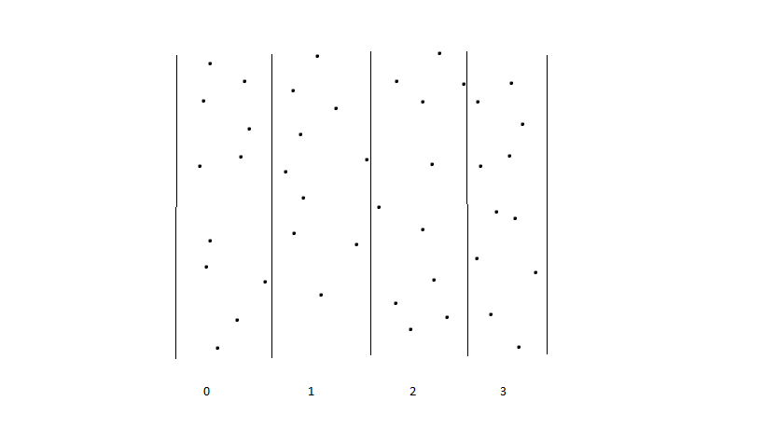
Parallel Algorithm
Divide and Conquer
Divide the plane containing the points among the processors
Sequentially find the local convex hull
Merge the convex hull from neighboring processors

Slide 13
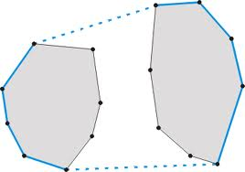
Merging the hulls
Find the tangent lines between the Hulls
Delete all edges with in tangent lines

Slide 14
Processor Communication Phases
Scatter
P1
P0
P2
P3
Merging the results
P0
P1
P2
P3
P0
P2
P0

Slide 15
References
http://www.cs.princeton.edu/courses/archive/fall05/cos226/lectures/geosearch.pdf
http://en.wikipedia.org/wiki/Range_searching
http://www.cs.ucsb.edu/~suri/cs235/RangeSearching.pdf
http://people.csail.mit.edu/indyk/6.838-old/handouts/lec5.pdf
http://www.win.tue.nl/~awolff/teaching/2009/2IL55/pdf/v05.pdf
http://2011.cccg.ca/PDFschedule/papers/paper106.pdf
http://www.cs.arizona.edu/classes/cs437/fall12/Lecture5.prn.pdf
http://www.cs.wustl.edu/~pless/506/l11w.html
http://en.wikipedia.org/wiki/Convex_hull
Parallel Computational Geometry – Aggarwal. A; O'Dunlaing. C; Yap.C
Parallel Processing and Applied Mathematics: 5th International Conference, PPAM 2003, Czestochowa, Poland, September 7-10, 2003. Revised Paper
Computational Geometry - Algorithms and Applications - Mark de Berg, TU Eindhoven , Otfried Cheong, KAIST ,Marc van Kreveld, Mark Overmars
Parallel Computational Geometry Selim G.Akl ,Kelly A.Lyons

Slide 16
Questions

